Slide 1
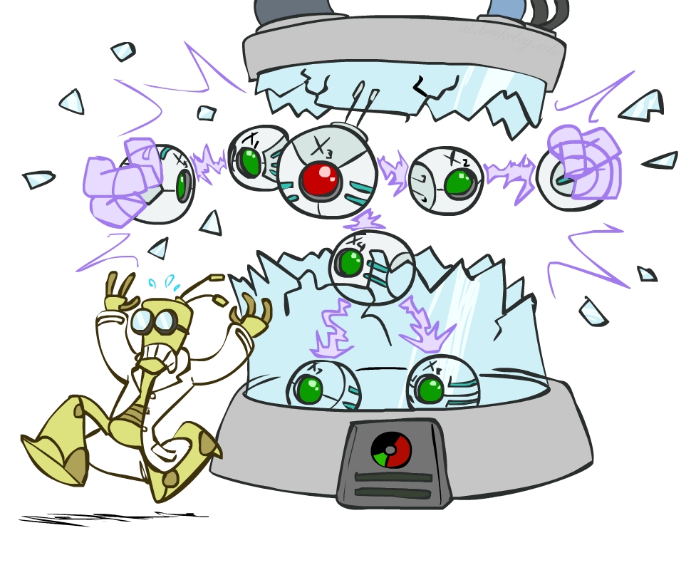
Artificial Intelligence
Bayes’ Nets: Independence
Instructors: David Suter and Qince Li
Course Delivered @ Harbin Institute of Technology
[Many slides adapted from those created by Dan Klein and Pieter Abbeel for CS188 Intro to AI at UC Berkeley. Some others from colleagues at Adelaide University.]
Notes:
Please retain proper attribution, including the reference to ai.berkeley.edu. Thanks!

Slide 2
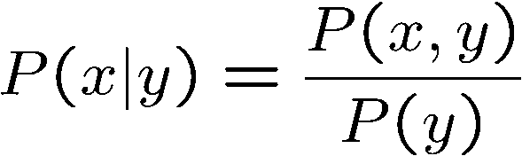
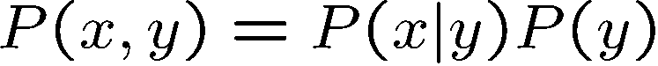
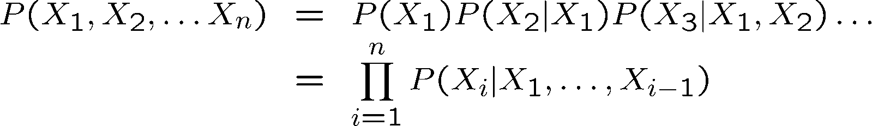
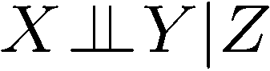
Probability Recap
Conditional probability
Product rule
Chain rule
X, Y independent if and only if:
X and Y are conditionally independent given Z if and only if:

Slide 3
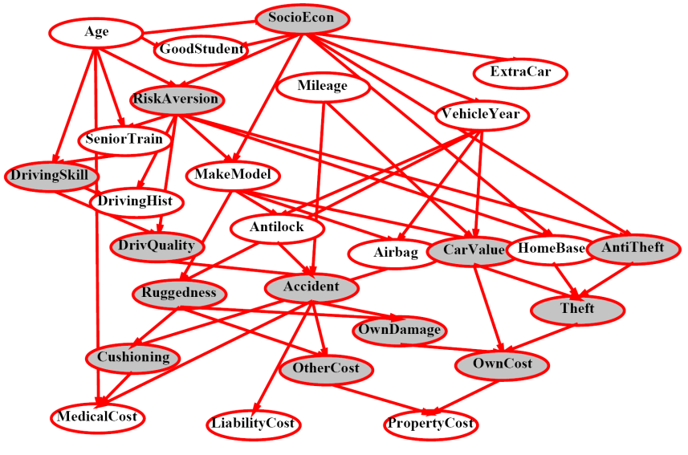
Bayes’ Nets
A Bayes’ net is an
efficient encoding
of a probabilistic
model of a domain
Questions we can ask:
Inference: given a fixed BN, what is P(X | e)?
Representation: given a BN graph, what kinds of distributions can it encode?
Modeling: what BN is most appropriate for a given domain?

Slide 4
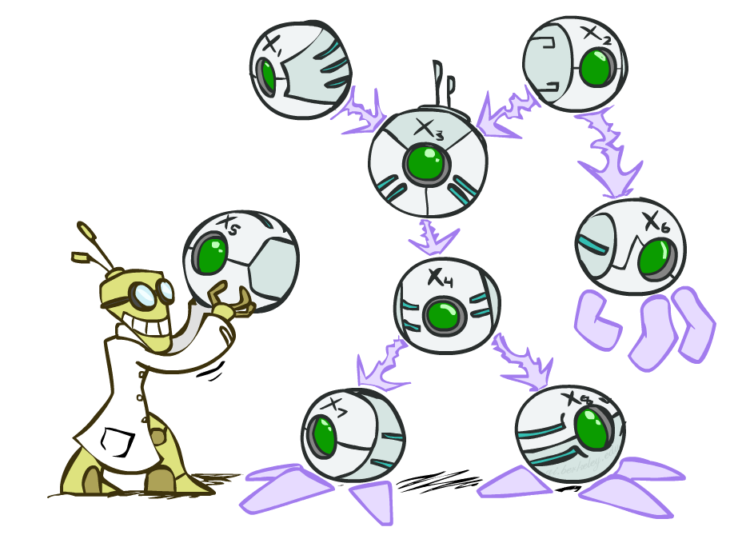
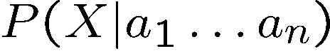
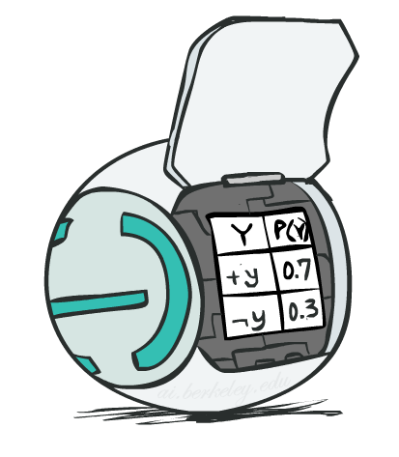
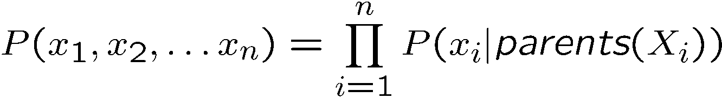
Bayes’ Net Semantics
A directed, acyclic graph, one node per random variable
A conditional probability table (CPT) for each node
A collection of distributions over X, one for each combination of parents’ values
Bayes’ nets implicitly encode joint distributions
As a product of local conditional distributions
To see what probability a BN gives to a full assignment, multiply all the relevant conditionals together:

Slide 5
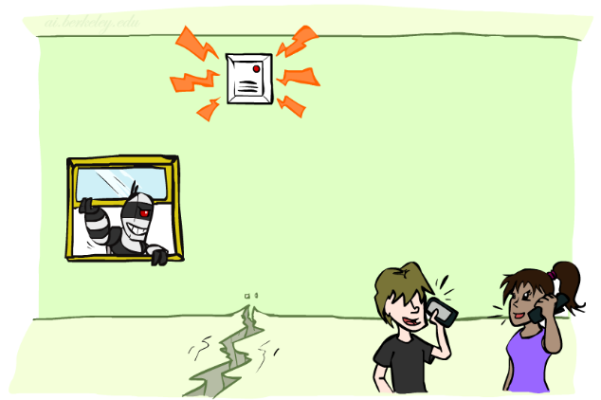
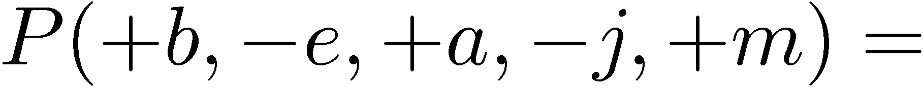
Example: Alarm Network
B | P(B)
+b | 0.001
-b | 0.999
B
E
E | P(E)
+e | 0.002
-e | 0.998
A
A | J | P(J|A)
+a | +j | 0.9
+a | -j | 0.1
-a | +j | 0.05
-a | -j | 0.95
A | M | P(M|A)
+a | +m | 0.7
+a | -m | 0.3
-a | +m | 0.01
-a | -m | 0.99
B | E | A | P(A|B,E)
+b | +e | +a | 0.95
+b | +e | -a | 0.05
+b | -e | +a | 0.94
+b | -e | -a | 0.06
-b | +e | +a | 0.29
-b | +e | -a | 0.71
-b | -e | +a | 0.001
-b | -e | -a | 0.999
J
M
Notes:
demo

Slide 6

Example: Alarm Network
B | P(B)
+b | 0.001
-b | 0.999
B
E
E | P(E)
+e | 0.002
-e | 0.998
A
A | J | P(J|A)
+a | +j | 0.9
+a | -j | 0.1
-a | +j | 0.05
-a | -j | 0.95
A | M | P(M|A)
+a | +m | 0.7
+a | -m | 0.3
-a | +m | 0.01
-a | -m | 0.99
B | E | A | P(A|B,E)
+b | +e | +a | 0.95
+b | +e | -a | 0.05
+b | -e | +a | 0.94
+b | -e | -a | 0.06
-b | +e | +a | 0.29
-b | +e | -a | 0.71
-b | -e | +a | 0.001
-b | -e | -a | 0.999
J
M
Notes:
demo

Slide 7
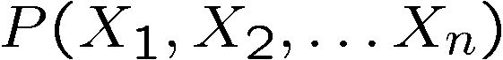
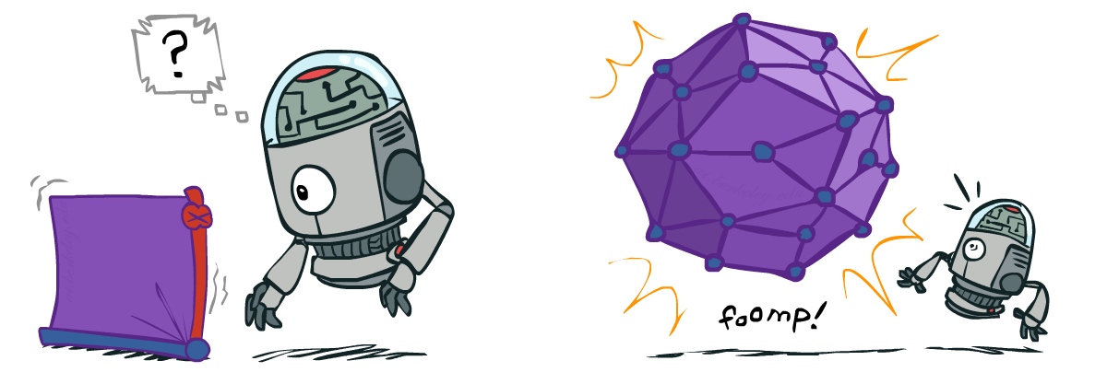
Size of a Bayes’ Net
How big is a joint distribution over N Boolean variables?
2^{N}
How big is an N-node net if nodes have up to k parents?
O(N * 2^{k+1})
Both give you the power to calculate
BNs: Huge space savings!
Also easier to elicit local CPTs
Also faster to answer queries (coming)

Slide 8

Bayes’ Nets
Representation
Conditional Independences
Probabilistic Inference
Learning Bayes’ Nets from Data

Slide 9
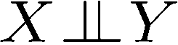
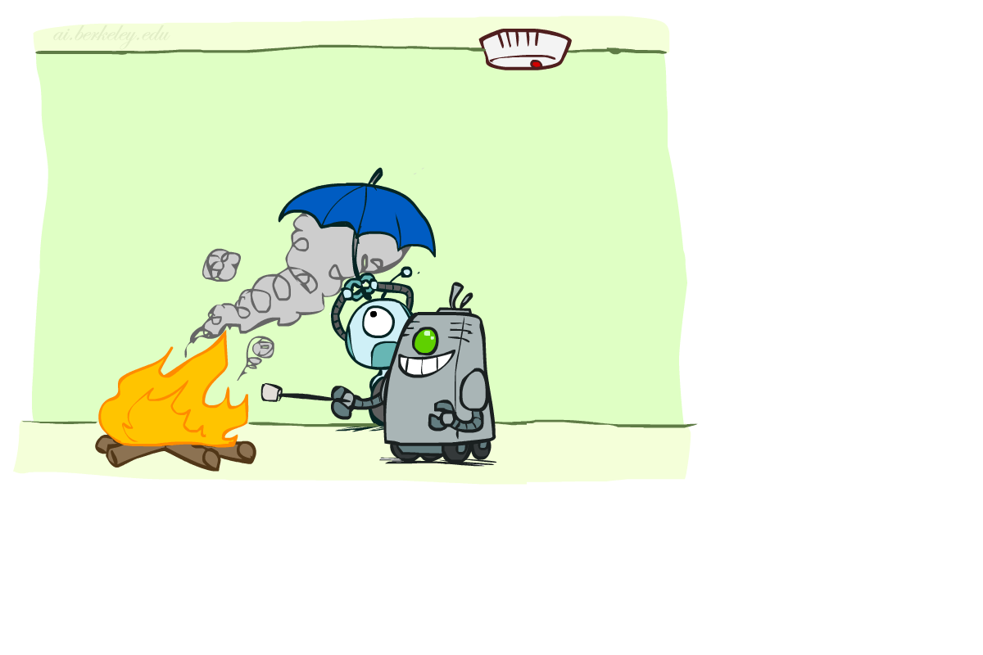
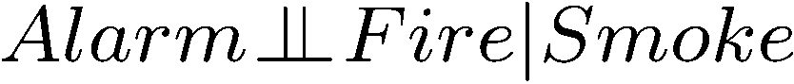
Conditional Independence
X and Y are independent if
X and Y are conditionally independent given Z
(Conditional) independence is a property of a distribution
Example:

Slide 10
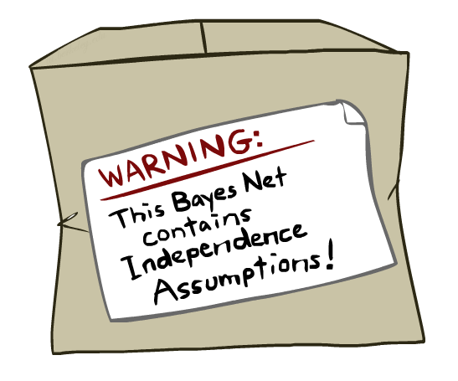
Bayes Nets: Assumptions
Assumptions we are required to make to define the Bayes net when given the graph:
Beyond above “chain rule → Bayes net” conditional independence assumptions
Often additional conditional independences
They can be read off the graph
Important for modeling: understand assumptions made when choosing a Bayes net graph
Notes:
Important for modeling: understanding which assumptions you are making!

Slide 11
Example
X
Y
Z
W
Conditional independence assumptions directly from simplifications in chain rule:
Additional implied conditional independence assumptions?

Slide 12
Independence in a BN
Important question about a BN:
Are two nodes independent given certain evidence?
If yes, can prove using algebra (tedious in general)
If no, can prove with a counter example
Example:
Question: are X and Z necessarily independent?
Answer: no. Example: low pressure causes rain, which causes traffic.
X can influence Z, Z can influence X (via Y)
Addendum: they could be independent: how?
X
Y
Z

Slide 13
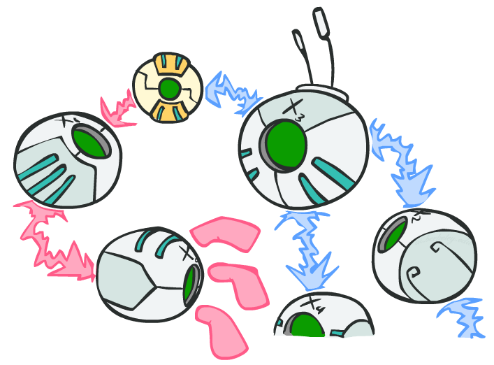
D-separation: Outline

Slide 14
D-separation: Outline
Study independence properties for triples
Analyze complex cases in terms of member triples
D-separation: a condition / algorithm for answering such queries

Slide 15
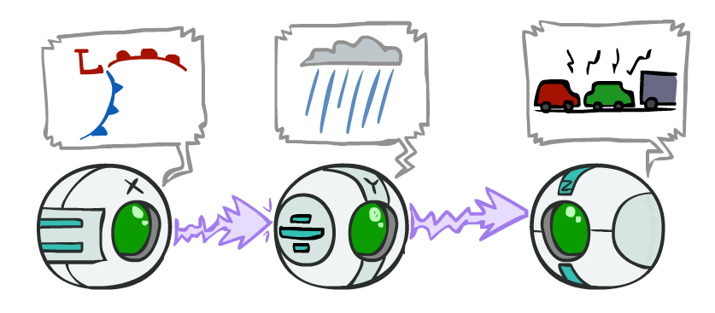
Causal Chains
This configuration is a “causal chain”
Guaranteed X independent of Z ? No!
One example set of CPTs for which X is not independent of Z is sufficient to show this independence is not guaranteed.
Example:
Low pressure causes rain causes traffic,
high pressure causes no rain causes no
traffic
In numbers:
P( +y | +x ) = 1, P( -y | - x ) = 1,
P( +z | +y ) = 1, P( -z | -y ) = 1
X: Low pressure Y: Rain Z: Traffic

Slide 16
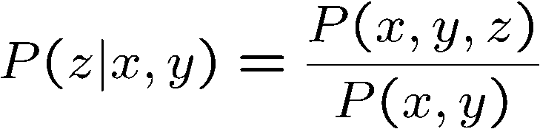
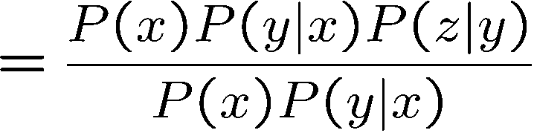
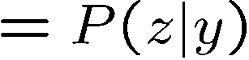
Causal Chains
This configuration is a “causal chain”
Guaranteed X independent of Z given Y?
Evidence along the chain “blocks” the influence
X: Low pressure Y: Rain Z: Traffic
Yes!

Slide 17
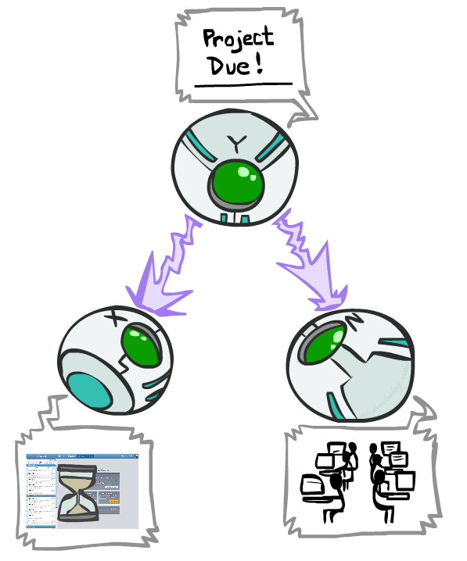
Common Cause
This configuration is a “common cause”
Guaranteed X independent of Z ? No!
One example set of CPTs for which X is not independent of Z is sufficient to show this independence is not guaranteed.
Example:
Project due causes both forums busy
and lab full
In numbers:
P( +x | +y ) = 1, P( -x | -y ) = 1,
P( +z | +y ) = 1, P( -z | -y ) = 1
Y: Project due
X: Forums busy
Z: Lab full

Slide 18
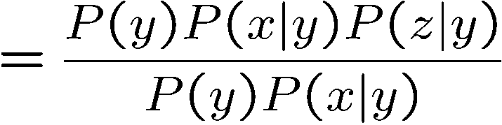
Common Cause
This configuration is a “common cause”
Guaranteed X and Z independent given Y?
Observing the cause blocks influence between effects.
Y: Project due
X: Forums busy
Z: Lab full
Yes!

Slide 19
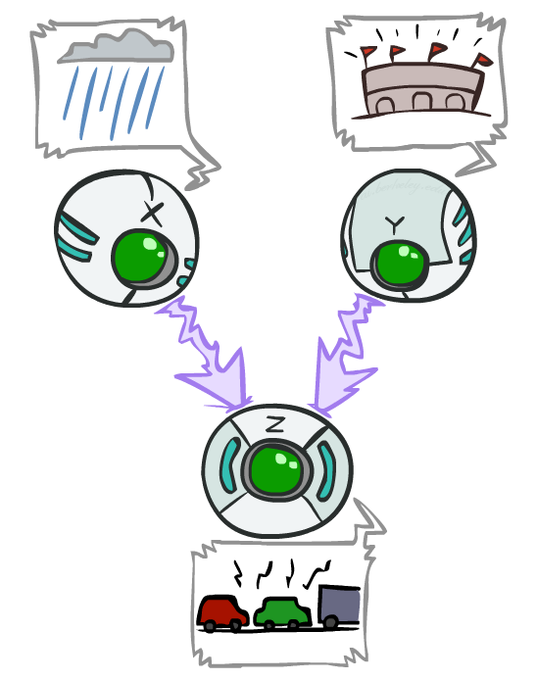
Common Effect
Last configuration: two causes of one effect (v-structures)
Are X and Y independent?
Yes: the ballgame and the rain cause traffic, but they are not correlated
Still need to prove they must be (try it!)
Are X and Y independent given Z?
No: seeing traffic puts the rain and the ballgame in competition as explanation.
This is backwards from the other cases
Observing an effect activates influence between possible causes.
X: Raining
Y: Ballgame
Z: Traffic

Slide 20
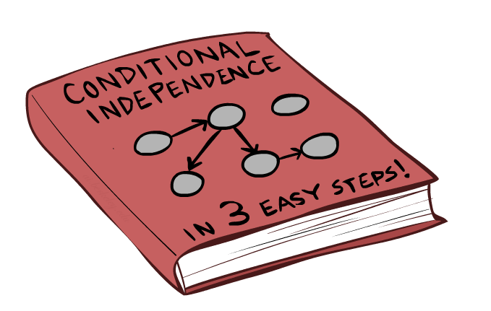
The General Case

Slide 21
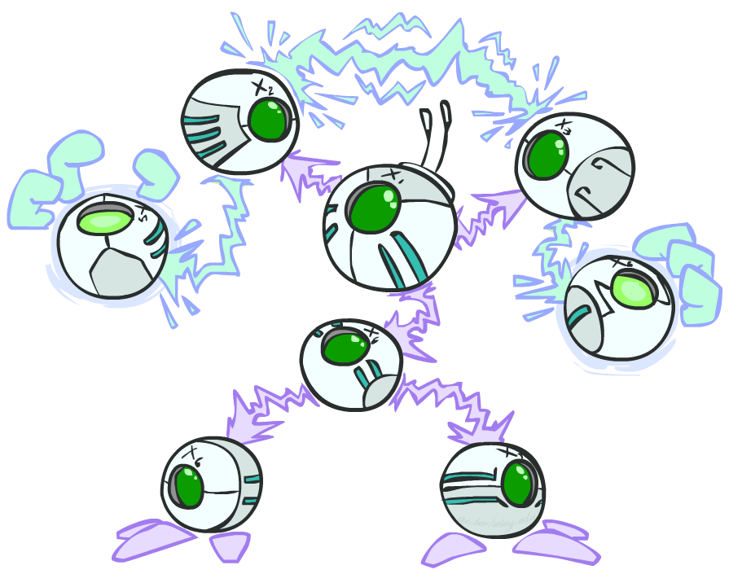
The General Case
General question: in a given BN, are two variables independent (given evidence)?
Solution: analyze the graph
Any complex example can be broken
into repetitions of the three canonical cases

Slide 22

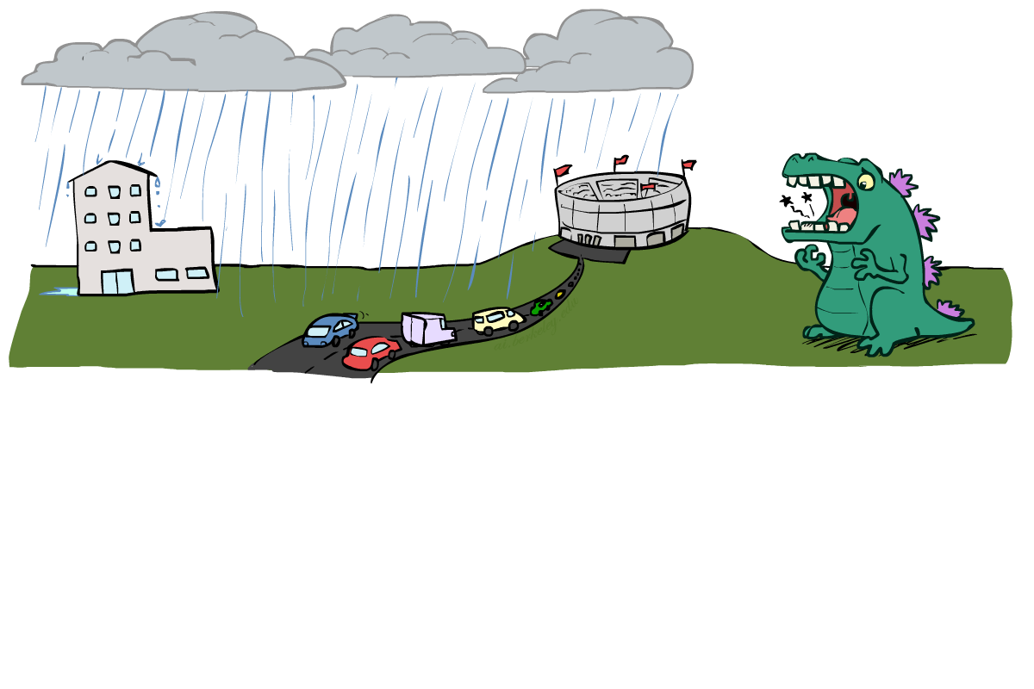
Reachability
L
Recipe: shade evidence nodes, look for paths in the resulting graph
Attempt 1: if two nodes are connected by an undirected path blocked by a shaded node, they are conditionally independent
Almost works, but not quite
Where does it break?
Answer: the v-structure at T doesn’t count as a link in a path unless “active”
R
B
D
T

Slide 23
Active / Inactive Paths
Question: Are X and Y conditionally independent given evidence variables {Z}?
Yes, if X and Y “d-separated” by Z
Consider all (undirected) paths from X to Y
No active paths = independence!
A path is active if each triple is active:
Causal chain A → B → C where B is unobserved (either direction)
Common cause A ← B → C where B is unobserved
Common effect (aka v-structure)
A → B ← C where B or one of its descendents is observed
All it takes to block a path is a single inactive segment
Active Triples
Inactive Triples

Slide 24
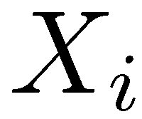
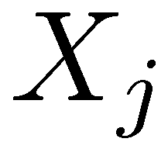

D-Separation
?
Query:
Check all (undirected!) paths between and
If one or more active, then independence not guaranteed
Otherwise (i.e. if all paths are inactive),
then independence is guaranteed

Slide 25

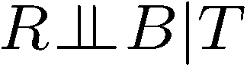
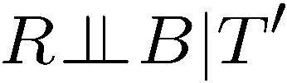
Example
Yes
R
B
T
T’
Notes:
T’: traffic report

Slide 26
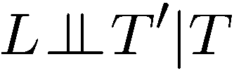
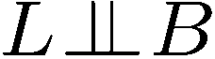
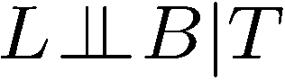
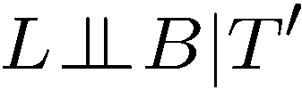
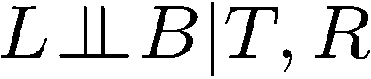
Example
L
Yes
R
B
Yes
D
T
Yes
T’

Slide 27
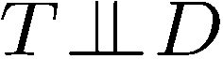
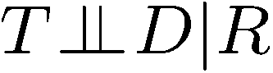
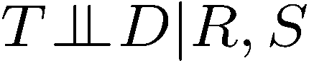
Example
Variables:
R: Raining
T: Traffic
D: Roof drips
S: I’m sad
Questions:
R
T
D
S
Yes

Slide 28

Structure Implications
Given a Bayes net structure, can run d-separation algorithm to build a complete list of conditional independences that are necessarily true of the form
This list determines the set of probability distributions that can be represented

Slide 29
Topology Limits Distributions
Given some graph topology G, only certain joint distributions can be encoded
The graph structure guarantees certain (conditional) independences
(There might be more independence)
Adding arcs increases the set of distributions, but has several costs
Full conditioning can encode any distribution
Y
Y
X
Z
X
Z
Y
X
Z
Y
X
Z
Y
Y
Y
X
Z
X
Z
X
Z
Y
Y
Y
X
Z
X
Z
X
Z

Slide 30
Bayes Nets Representation Summary
Bayes nets compactly encode joint distributions
Guaranteed independencies of distributions can be deduced from BN graph structure
D-separation gives precise conditional independence guarantees from graph alone
A Bayes’ net’s joint distribution may have further (conditional) independence that is not detectable until you inspect its specific distribution

Slide 31
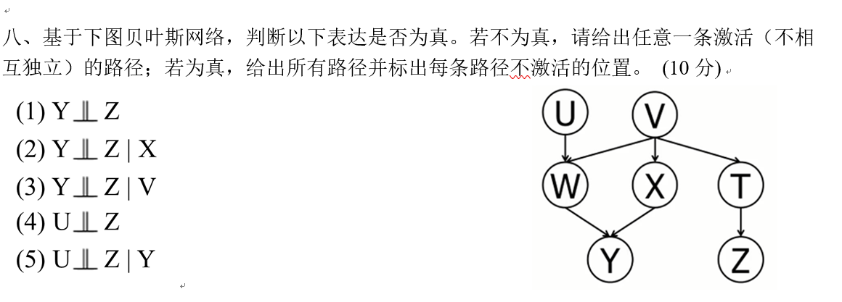
Example

Slide 32
Bayes’ Nets
Representation
Conditional Independences
Probabilistic Inference
Enumeration (exact, exponential complexity)
Variable elimination (exact, worst-case
exponential complexity, often better)
Probabilistic inference is NP-complete
Sampling (approximate)
Learning Bayes’ Nets from Data

Slide 33
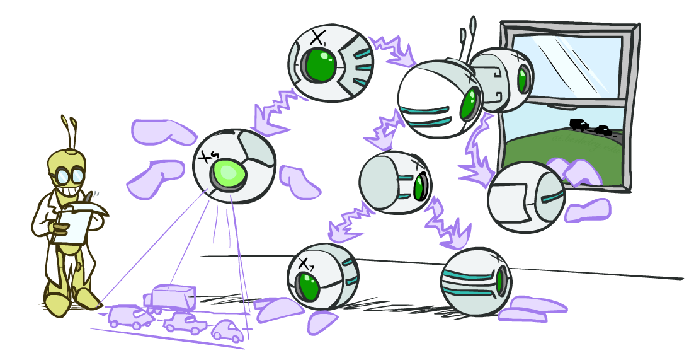
Artificial Intelligence
Bayes’ Nets: Inference
Instructors: David Suter and Qince Li
Course Delivered @ Harbin Institute of Technology
[Many slides adapted from those created by Dan Klein and Pieter Abbeel for CS188 Intro to AI at UC Berkeley. Some others from colleagues at Adelaide University.]
Notes:
Please retain proper attribution, including the reference to ai.berkeley.edu. Thanks!

Slide 34
Bayes’ Net Representation
A directed, acyclic graph, one node per random variable
A conditional probability table (CPT) for each node
A collection of distributions over X, one for each combination of parents’ values
Bayes’ nets implicitly encode joint distributions
As a product of local conditional distributions
To see what probability a BN gives to a full assignment, multiply all the relevant conditionals together:

Slide 35

Example: Alarm Network
B | P(B)
+b | 0.001
-b | 0.999
E | P(E)
+e | 0.002
-e | 0.998
Burglary
Earthqk
Alarm
B | E | A | P(A|B,E)
+b | +e | +a | 0.95
+b | +e | -a | 0.05
+b | -e | +a | 0.94
+b | -e | -a | 0.06
-b | +e | +a | 0.29
-b | +e | -a | 0.71
-b | -e | +a | 0.001
-b | -e | -a | 0.999
John calls
Mary calls
A | J | P(J|A)
+a | +j | 0.9
+a | -j | 0.1
-a | +j | 0.05
-a | -j | 0.95
A | M | P(M|A)
+a | +m | 0.7
+a | -m | 0.3
-a | +m | 0.01
-a | -m | 0.99
[Demo: BN Applet]
Notes:
Demo:
Draw network
Specify the CPTs
Then query, e.g., Mary Calls --- not something we specified, inference computed this for us
P(B) = ?
P(B | +e) = ?
Independence
P(B) = ?
P(B | +m) = ?
Show explaining away

Slide 36
Example: Alarm Network
B | P(B)
+b | 0.001
-b | 0.999
B
E
E | P(E)
+e | 0.002
-e | 0.998
A
A | J | P(J|A)
+a | +j | 0.9
+a | -j | 0.1
-a | +j | 0.05
-a | -j | 0.95
A | M | P(M|A)
+a | +m | 0.7
+a | -m | 0.3
-a | +m | 0.01
-a | -m | 0.99
B | E | A | P(A|B,E)
+b | +e | +a | 0.95
+b | +e | -a | 0.05
+b | -e | +a | 0.94
+b | -e | -a | 0.06
-b | +e | +a | 0.29
-b | +e | -a | 0.71
-b | -e | +a | 0.001
-b | -e | -a | 0.999
J
M
Notes:
demo

Slide 37

Example: Alarm Network
B | P(B)
+b | 0.001
-b | 0.999
B
E
E | P(E)
+e | 0.002
-e | 0.998
A
A | J | P(J|A)
+a | +j | 0.9
+a | -j | 0.1
-a | +j | 0.05
-a | -j | 0.95
A | M | P(M|A)
+a | +m | 0.7
+a | -m | 0.3
-a | +m | 0.01
-a | -m | 0.99
B | E | A | P(A|B,E)
+b | +e | +a | 0.95
+b | +e | -a | 0.05
+b | -e | +a | 0.94
+b | -e | -a | 0.06
-b | +e | +a | 0.29
-b | +e | -a | 0.71
-b | -e | +a | 0.001
-b | -e | -a | 0.999
J
M
Notes:
demo

Slide 38

Bayes’ Nets
Representation
Conditional Independences
Probabilistic Inference
Enumeration (exact, exponential complexity)
Variable elimination (exact, worst-case exponential complexity, often better)
Inference is NP-complete
Sampling (approximate)
Learning Bayes’ Nets from Data

Slide 39

Inference
Inference: calculating some useful quantity from a joint probability distribution
Examples:
Posterior probability
Most likely explanation:

Slide 40
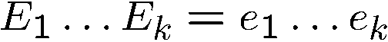
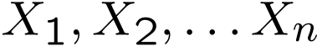
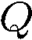
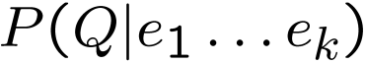
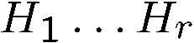
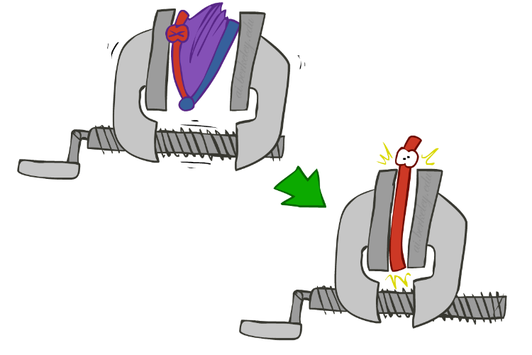
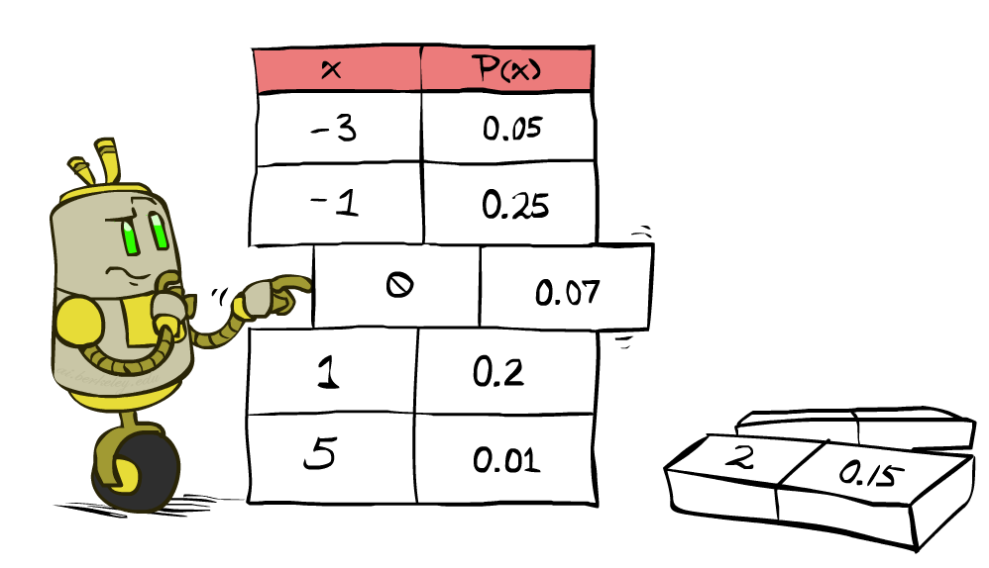




Inference by Enumeration
* Works fine with multiple query variables, too
General case:
Evidence variables:
Query* variable:
Hidden variables:
We want:
All variables
Step 1: Select the entries consistent with the evidence
Step 2: Sum out H to get joint of Query and evidence
Step 3: Normalize

Slide 41
Inference by Enumeration in Bayes’ Net
Given unlimited time, inference in BNs is easy
Reminder of inference by enumeration by example:
B
E
A
J
M

Slide 42

Inference by Enumeration?

Slide 43


Inference by Enumeration vs. Variable Elimination
Why is inference by enumeration so slow?
You join up the whole joint distribution before you sum out the hidden variables
Idea: interleave joining and marginalizing!
Called “Variable Elimination”
Still NP-hard, but usually much faster than inference by enumeration
First we’ll need some new notation: factors

Slide 44

Factor Zoo

Slide 45



Factor Zoo I
Joint distribution: P(X,Y)
Entries P(x,y) for all x, y
Sums to 1
Selected joint: P(x,Y)
A slice of the joint distribution
Entries P(x,y) for fixed x, all y
Sums to P(x)
Number of capitals = dimensionality of the table
T | W | P
hot | sun | 0.4
hot | rain | 0.1
cold | sun | 0.2
cold | rain | 0.3
T | W | P
cold | sun | 0.2
cold | rain | 0.3

Slide 46






Factor Zoo II
Single conditional: P(Y | x)
Entries P(y | x) for fixed x, all y
Sums to 1
Family of conditionals:
P(X |Y)
Multiple conditionals
Entries P(x | y) for all x, y
Sums to |Y|
T | W | P
cold | sun | 0.4
cold | rain | 0.6
T | W | P
hot | sun | 0.8
hot | rain | 0.2
cold | sun | 0.4
cold | rain | 0.6

Slide 47




Factor Zoo III
Specified family: P( y | X )
Entries P(y | x) for fixed y,
but for all x
Sums to … who knows!
T | W | P
hot | rain | 0.2
cold | rain | 0.6

Slide 48




Factor Zoo Summary
In general, when we write P(Y₁ … Y_{N} | X₁ … X_{M})
It is a “factor,” a multi-dimensional array
Its values are P(y₁ … y_{N} | x₁ … x_{M})
Any assigned (=lower-case) X or Y is a dimension missing (selected) from the array

Slide 49



Example: Traffic Domain
Random Variables
R: Raining
T: Traffic
L: Late for class!
+r | 0.1
-r | 0.9
R
T
+r | +t | 0.8
+r | -t | 0.2
-r | +t | 0.1
-r | -t | 0.9
L
+t | +l | 0.3
+t | -l | 0.7
-t | +l | 0.1
-t | -l | 0.9

Slide 50

Variable Elimination (VE)

Slide 51







Inference by Enumeration: Procedural Outline
Track objects called factors
Initial factors are local CPTs (one per node)
Any known values are selected
E.g. if we know , the initial factors are
Procedure: Join all factors, then eliminate all hidden variables
+r | 0.1
-r | 0.9
+r | +t | 0.8
+r | -t | 0.2
-r | +t | 0.1
-r | -t | 0.9
+t | +l | 0.3
+t | -l | 0.7
-t | +l | 0.1
-t | -l | 0.9
+r | 0.1
-r | 0.9
+r | +t | 0.8
+r | -t | 0.2
-r | +t | 0.1
-r | -t | 0.9
+t | +l | 0.3
-t | +l | 0.1

Slide 52





Operation 1: Join Factors
First basic operation: joining factors
Combining factors:
Just like a database join
Get all factors over the joining variable
Build a new factor over the union of the variables involved
Example: Join on R
Computation for each entry: pointwise products
R
+r | 0.1
-r | 0.9
+r | +t | 0.8
+r | -t | 0.2
-r | +t | 0.1
-r | -t | 0.9
+r | +t | 0.08
+r | -t | 0.02
-r | +t | 0.09
-r | -t | 0.81
R,T
T

Slide 53

Example: Multiple Joins

Slide 54



Example: Multiple Joins
+r | 0.1
-r | 0.9
R
Join R
Join T
+r | +t | 0.08
+r | -t | 0.02
-r | +t | 0.09
-r | -t | 0.81
R, T, L
T
+r | +t | 0.8
+r | -t | 0.2
-r | +t | 0.1
-r | -t | 0.9
R, T
+r | +t | +l | 0.024
+r | +t | -l | 0.056
+r | -t | +l | 0.002
+r | -t | -l | 0.018
-r | +t | +l | 0.027
-r | +t | -l | 0.063
-r | -t | +l | 0.081
-r | -t | -l | 0.729
L
L
+t | +l | 0.3
+t | -l | 0.7
-t | +l | 0.1
-t | -l | 0.9
+t | +l | 0.3
+t | -l | 0.7
-t | +l | 0.1
-t | -l | 0.9

Slide 55



Operation 2: Eliminate
Second basic operation: marginalization
Take a factor and sum out a variable
Shrinks a factor to a smaller one
A projection operation
Example:
+r | +t | 0.08
+r | -t | 0.02
-r | +t | 0.09
-r | -t | 0.81
+t | 0.17
-t | 0.83

Slide 56



Multiple Elimination
R, T, L
T, L
L
+r | +t | +l | 0.024
+r | +t | -l | 0.056
+r | -t | +l | 0.002
+r | -t | -l | 0.018
-r | +t | +l | 0.027
-r | +t | -l | 0.063
-r | -t | +l | 0.081
-r | -t | -l | 0.729
Sum
out R
Sum
out T
+t | +l | 0.051
+t | -l | 0.119
-t | +l | 0.083
-t | -l | 0.747
+l | 0.134
-l | 0.886

Slide 57

Thus Far: Multiple Join, Multiple Eliminate (= Inference by Enumeration)

Slide 58

Marginalizing Early (= Variable Elimination)

Slide 59
Traffic Domain
R
Inference by Enumeration
Variable Elimination
T
L
Join on r
Join on r
Join on t
Eliminate r
Eliminate r
Join on t
Eliminate t
Eliminate t

Slide 60


Marginalizing Early! (aka VE)
Join R
Sum out R
Join T
Sum out T
+r | +t | 0.08
+r | -t | 0.02
-r | +t | 0.09
-r | -t | 0.81
+r | 0.1
-r | 0.9
+t | 0.17
-t | 0.83
R
T
T, L
R, T
L
+r | +t | 0.8
+r | -t | 0.2
-r | +t | 0.1
-r | -t | 0.9
T
L
L
+t | +l | 0.051
+t | -l | 0.119
-t | +l | 0.083
-t | -l | 0.747
+l | 0.134
-l | 0.866
L
+t | +l | 0.3
+t | -l | 0.7
-t | +l | 0.1
-t | -l | 0.9
+t | +l | 0.3
+t | -l | 0.7
-t | +l | 0.1
-t | -l | 0.9
+t | +l | 0.3
+t | -l | 0.7
-t | +l | 0.1
-t | -l | 0.9

Slide 61




Evidence
If evidence, start with factors that select that evidence
No evidence uses these initial factors:
Computing , the initial factors become:
We eliminate all vars other than query + evidence
+r | 0.1
-r | 0.9
+r | +t | 0.8
+r | -t | 0.2
-r | +t | 0.1
-r | -t | 0.9
+t | +l | 0.3
+t | -l | 0.7
-t | +l | 0.1
-t | -l | 0.9
+r | 0.1
+r | +t | 0.8
+r | -t | 0.2
+t | +l | 0.3
+t | -l | 0.7
-t | +l | 0.1
-t | -l | 0.9

Slide 62

Evidence II
Result will be a selected joint of query and evidence
E.g. for P(L | +r), we would end up with:
To get our answer, just normalize this!
That ’s it!
Normalize
+r | +l | 0.026
+r | -l | 0.074
+l | 0.26
-l | 0.74

Slide 63




General Variable Elimination
Query:
Start with initial factors:
Local CPTs (but instantiated by evidence)
While there are still hidden variables (not Q or evidence):
Pick a hidden variable H
Join all factors mentioning H
Eliminate (sum out) H
Join all remaining factors and normalize

Slide 64










Example
Choose A

Slide 65




Example
Choose E
Finish with B
Normalize

Slide 66





Example 2: P(B|a)
Start / Select
Join on B
Normalize
B
a, B
B | P
+b | 0.1
¬b | 0.9
a
A | B | P
+a | +b | 0.08
+a | ¬b | 0.09
A | B | P
+a | +b | 8/17
+a | ¬b | 9/17
B | A | P
+b | +a | 0.8
b | ¬a | 0.2
¬b | +a | 0.1
¬b | ¬a | 0.9

Slide 67

Same Example in Equations
marginal can be obtained from joint by summing out
use Bayes’ net joint distribution expression
use x*(y+z) = xy + xz
joining on a, and then summing out gives f₁
use x*(y+z) = xy + xz
joining on e, and then summing out gives f₂
All we are doing is exploiting uwy + uwz + uxy + uxz + vwy + vwz + vxy +vxz = (u+v)(w+x)(y+z) to improve computational efficiency!

Slide 68








Another Variable Elimination Example
Computational complexity critically depends on the largest factor being generated in this process. Size of factor = number of entries in table. In example above (assuming binary) all factors generated are of size 2 --- as they all only have one variable (Z, Z, and X₃ respectively).

Slide 69




Variable Elimination Ordering
For the query P(X_{n}|y₁,…,y_{n}) work through the following two different orderings as done in previous slide: Z, X₁, …, X_{n-1} and X₁, …, X_{n-1}, Z. What is the size of the maximum factor generated for each of the orderings?
Answer: 2^{n+1} versus 2² (assuming binary)
In general: the ordering can greatly affect efficiency.
…
…

Slide 70
VE: Computational and Space Complexity
The computational and space complexity of variable elimination is determined by the largest factor
The elimination ordering can greatly affect the size of the largest factor.
E.g., previous slide’s example 2^{n} vs. 2
Does there always exist an ordering that only results in small factors?
No!

Slide 71
















Worst Case Complexity?
CSP:
If we can answer P(z) equal to zero or not, we answered whether the 3-SAT problem has a solution.
Hence inference in Bayes’ nets is NP-hard. No known efficient probabilistic inference in general.
…
…

Slide 72
Bayes’ Nets
U
V
W
P(U|+z)
X
Y
Z

Slide 73

Bayes’ Nets
Representation
Conditional Independences
Probabilistic Inference
Enumeration (exact, exponential complexity)
Variable elimination (exact, worst-case exponential complexity, often better)
Inference is NP-complete
Sampling (approximate)
Learning Bayes’ Nets from Data

